Slide 1

Azure DevOps
#AzureDevOps
https://azure.com/devops @AzureDevOps https://aka.ms/AzureDevOpsForum https://aka.ms/DevOpsBlog/

Slide 2





Introducing Azure DevOps
Azure Boards
Azure Pipelines
Azure Repos
Deliver value to your users faster using proven agile tools to plan, track, and discuss work across your teams.
Build, test, and deploy with CI/CD that works with any language, platform, and cloud. Connect to GitHub or any other Git provider and deploy continuously.
Get unlimited, cloud-hosted private Git repos and collaborate to build better code with pull requests and advanced file management.
Azure Test Plans
Azure Artifacts
Test and ship with confidence using manual and exploratory testing tools.
Create, host, and share packages with your team, and add artifacts to your CI/CD pipelines with a single click.

Slide 3



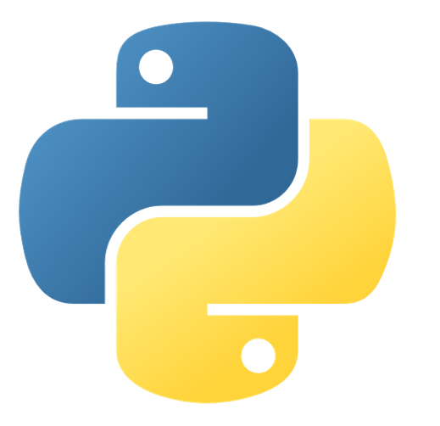

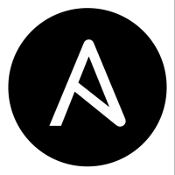

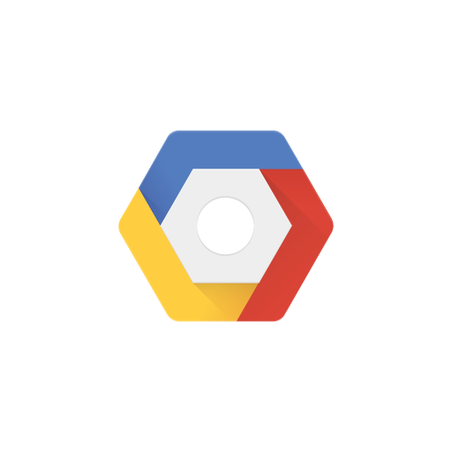

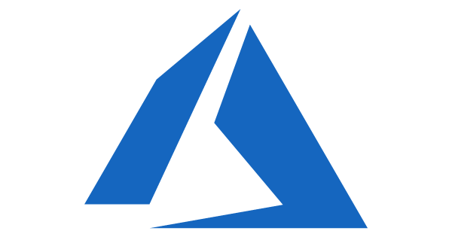

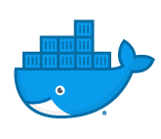
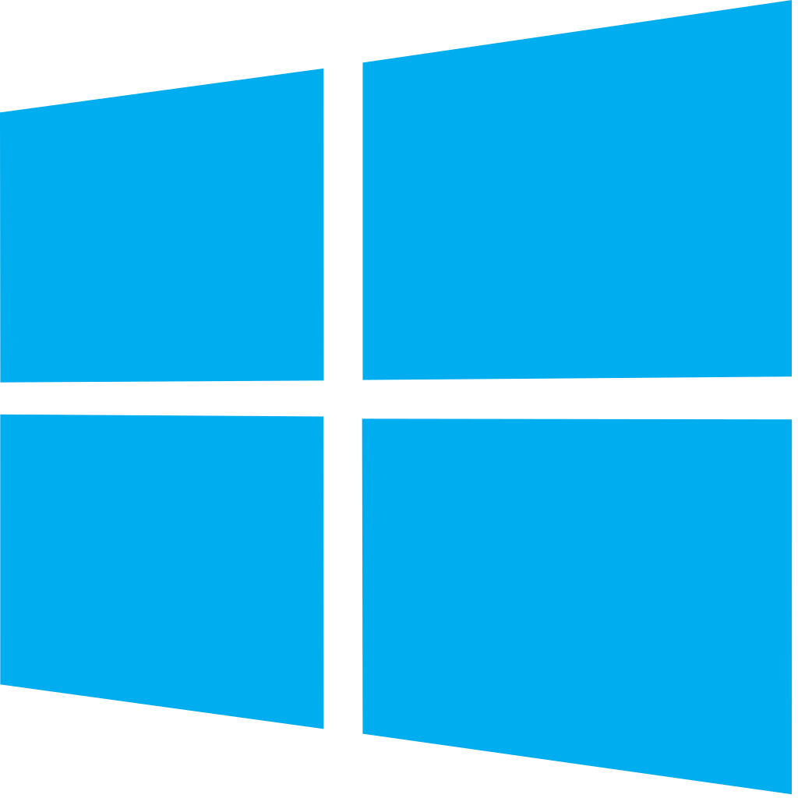
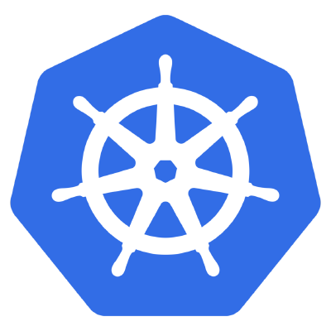

Azure DevOps: Choose what you love
Your tools, languages, and clouds
Azure DevOps lets developers choose the tools and languages that are right for them
Mix and match to create workflows with tools from Microsoft, open source or your favorite 3rd party tools
Target any cloud, on-prem or both and deploy to the servers you need

Slide 4
Azure DevOps
Better together
Azure Boards
Azure Repos
Azure Pipelines
Azure Test Plans
Azure Artifacts
An end-to-end solution for organizations looking for an enterprise-grade toolchain
Fully Integrated with end to end traceability
Scalable to any team and project size
Highly available, multi region, hybrid cloud & on-prem
Customer Support
Consistent admin and access control

Slide 5

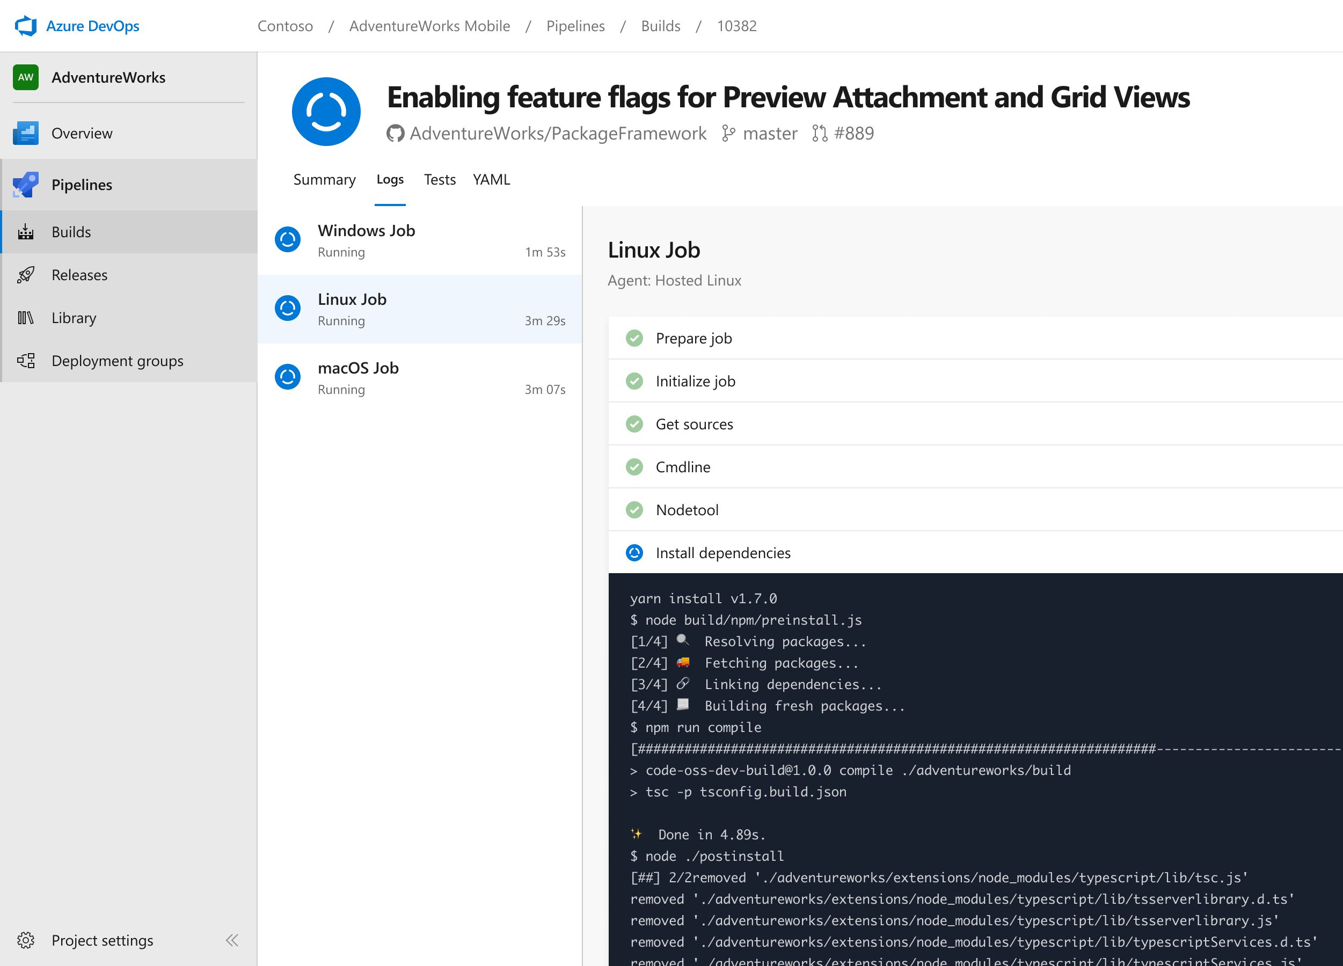


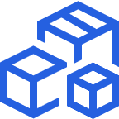
Azure Pipelines
Cloud-hosted pipelines for Linux, Windows and macOS.
Any language, any platform, any cloud
Build, test, and deploy Node.js, Python, Java, PHP, Ruby, C/C++, .NET, Android, and iOS apps. Run in parallel on Linux, macOS, and Windows. Deploy to Azure, AWS, GCP or on-premises
Extensible
Explore and implement a wide range of community-built build, test, and deployment tasks, along with hundreds of extensions from Slack to SonarCloud. Support for YAML, reporting and more
Containers and Kubernetes
Easily build and push images to container registries like Docker Hub and Azure Container Registry. Deploy containers to individual hosts or Kubernetes.

Slide 6
Building & Deploying Azure DevOps with Azure DevOps
#AzureDevOps
Demo

Slide 7


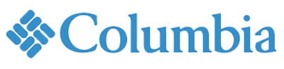

Azure DevOps supports small teams to the largest enterprises
Instead of telling people to wait for 6 months for a new feature, we can give it to them in a few weeks…Our 2800 worldwide developers can use the same backlog, user stories and tests whether they’re on Windows or Linux… building for iOS or Android.
Speed is gained in moving to the PaaS offering of Azure DevOps. PaaS provides regularly released features and a future-proof capability, eliminating the need for Accenture to maintain infrastructure and go through upgrade cycles.
“
“
”
”
Microsoft made it really easy to break outside the silos… and tie the DevOps process into the fulfilment of business process. Without the tools that we have today, we would not be successful.
Branches sync 500 percent faster. Builds are 400 percent faster, with the typically six-hour process reduced to 90 minutes. We (now have) a highly streamlined process that operates with a few button clicks—and one-button deployment.
“
“
”
”

Slide 8
Thank You

